Slide 1
Comparisons Of Round Robin Algorithms
Naga Ganesh Kurapati, Vishal Sundarrajan, Swapnil Suresh Chaughule

Slide 2
Round Robin Algorithm
Compare standard RR with other RR and find the greatest improvement over standard RR
Comparing 5 different RR algorithms
RR is a pre-emptive process scheduling algorithm
Each process gets its turn for a fixed time = Quantum Time
Fixed
variable (Vary based on the algorithm)
The ready queue works like a circular queue
All processes in this algorithm are kept in the circular queue also known as ready queue
Each New process is added to the tail of the ready/circular queue

Slide 3
Parameters of Concern (Input)
Process | Arrival Time | Burst Time | Priority
P1 P2 P3 P4 P5 P6 | 0 0 3 5 10 13 | 7 5 4 4 8 8 | 2 1 6 4 3 5
Arrival Time
The time at which a process enters the system
Pick a random inter-arrival time and trigger an event
Poisson would be ideal
Burst Time
The total time taken by a process before it leaves the system
Pick a random burst time
Exponential distribution (related to inter-arrival time of poisson)
Priority
Largest number corresponds to a high priority process

Slide 4
Parameters of Concern (Output)
Standard Round Robin
Gantt Chart
0 4 8 12 15 19 20 24 28 32 36
Time Quantum = 4
Number of Context Switches = 9 (Store the states of the processes)
Average Turnaround Time = 17.17 (Time spent in the Queue)
Average Waiting Time = 11.17 (Service Time – Arrival Time)
Run it several times for different scenarios to find the average of all the above values.
P1 | P2 | P3 | P1 | P4 | P2 | P5 | P6 | P5 | P6

Slide 5
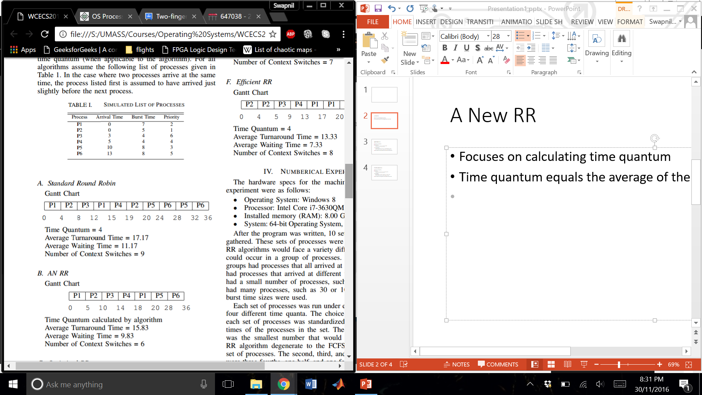
A New RR
Focuses on calculating an ideal time quantum

Slide 6
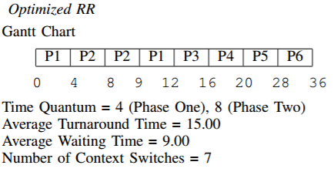
Optimized RR
First phase,
Processes are executed just like Standard RR
Each process runs for one time slice
Second phase,
Processes are executed in order of their remaining burst time
Process with shorter time run before process with longer time

Slide 7
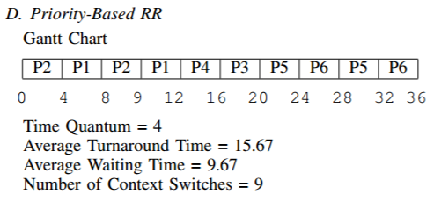
Priority Based RR
First Phase,
Processes are executed in order of their priorities
Each process runs for one time slice
Second Phase,
New priorities are assigned depending on the burst time
Process with shorter burst time have highest priority

Slide 8
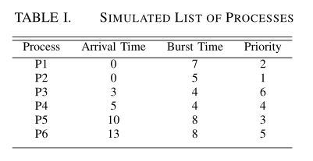
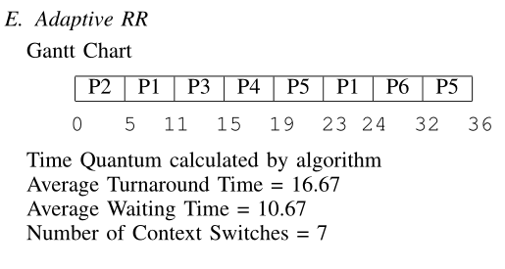
Adaptive RR
Processes are sorted by their burst times, shorter process at the front of the ready queue
Even number of processes in queue then time quantum is average of the all burst times
If odd, equal to burst time of the middle process in the ready queue
Any process comes in middle of the execution, then it is not scheduled in current round.

Slide 9
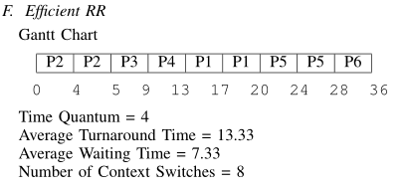
Efficient RR
Combines Shortest remaining algo. and Standard RR
Process with shortest remaining burst time is selected first.
When new processes comes in, at end of time slice process with shortest remaining burst time is selected first.
Long process will suffer starvation

Slide 10
Which is BEST?
Type | Average Turnaround Time | Average Waiting Time | Number of Context Switches
Standard Round Robin | 17.17 | 11.17 | 9
AN RR | 15.83 | 9.83 | 6
Optimized RR | 15.0 | 9.0 | 7
Priority-Based RR | 15.67 | 9.67 | 9
Adaptive RR | 16.67 | 10.67 | 7
Efficient RR | 13.33 | 7.33 | 8

Slide 11
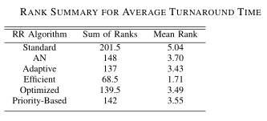
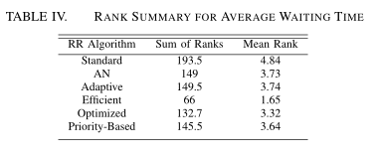
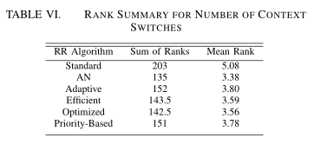
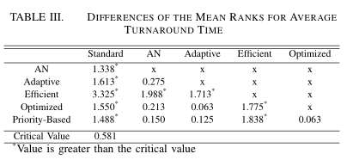
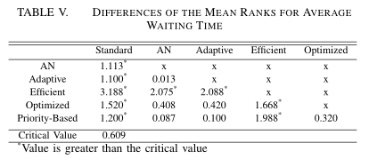
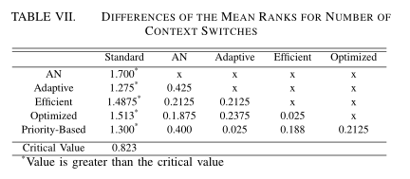
Advance research - For reference
Friedman statistical test

Slide 12
Thank you
References :
Comparisons of Improved Round Robin Algorithms by Christopher McGuire and Jeonghwa Lee

